Slide 1

CS+Social Good
Design Thinking Crash Course

Slide 2
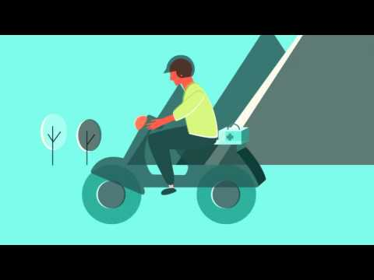
Design Thinking

Slide 3
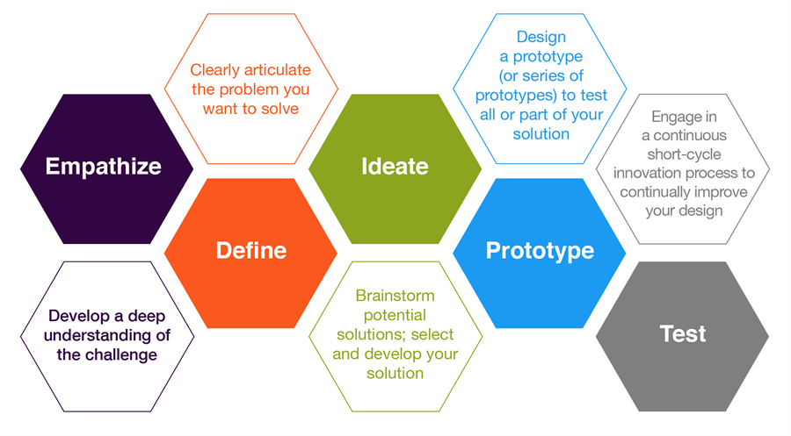
Design Thinking

Slide 4
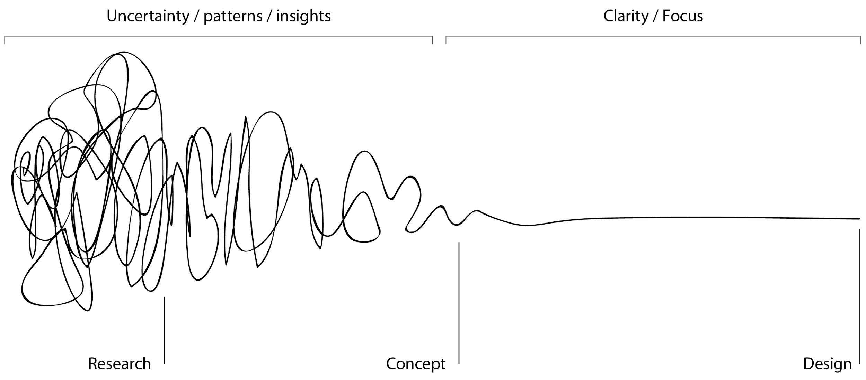
Design Thinking
Notes:
Important to stress the

Slide 5
Overview of Your Task
In this activity, you will be paired with another student and tasked with using your design thinking skills to redesign the school backpack experience.

Slide 6


Empathize
Empathy is the foundation of a human-centered design process; by deeply understanding people, we are better able to design for them.
Immerse
Observe
Engage
Discover
Understand

Slide 7
Empathy Activity
Get with your partner
Spend 5 minutes each interviewing each other
Make sure that you:
Don’t have any preconceptions about your partner’s situation
Understand your partner’s views about his/her academic situation

Slide 8
Questions to Consider
How do you feel about . . . ?
Can you tell me about how you started . . . ?
What is your best/worst/craziest/most memorable experience with . . .?
What’s something I would find surprising about . . . ?
How do you feel about . . .?
What’s a typical day like doing . . . ? An atypical day?
Why is . . . important to you? Why do you feel that way?

Slide 9
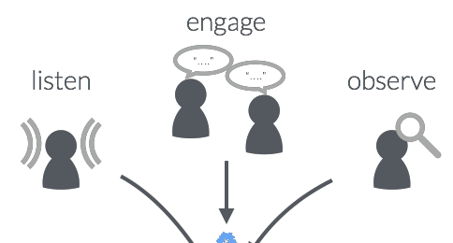
Define
Focus in on a specific and meaningful challenge.
Goal: Take your insights from empathy and generate an actionable problem statement and your unique design vision
-Pick a specific problem - not a preconceived idea

Slide 10

Define Activity
Take 3 minutes on your own to write a clear definition of the issue your partner is facing so you can fully understand the issue before you begin to think of a solution.
Remember: Listen to your partner and think of exactly what they need improved. Avoid inserting yourself into the issue
and defining a problem you have or assume they have

Slide 11

Ideate
Brainstorm as many possible solutions to the problem. THINK BIG!
There are no stupid ideas!

Slide 12

Ideate Activity
Take 5 minutes to brainstorm solutions for the issue you defined using the post it notes.
Create a board of post it note ideas on your desk - the more ideas you come up with the better.

Slide 13
If you get stuck...
How would you solve this problem with $1,000,000? What about $100
How could you solve this problem by tomorrow? What about if you had a year? 100 years?
What would Oprah do? What about your grandma?
How would you design a solution without technology?
How would you solve this problem if you just had yourself and a friend? What if you had the President on board?
Notes:
Give students 10-15 post it notes

Slide 14
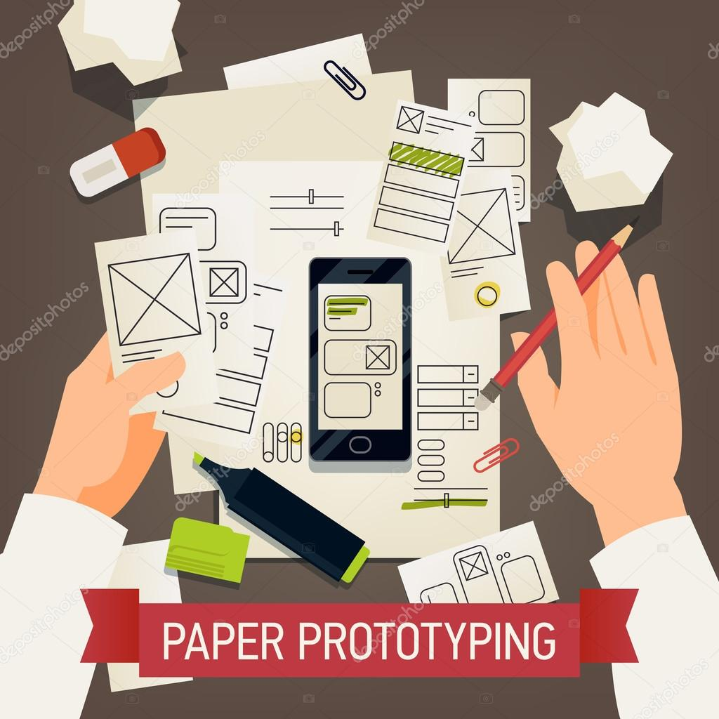
Prototype
This is the phase where your idea comes to life!

Slide 15

Prototype Activity
When deciding on your best idea think which…
Is the most feasible
Has the greatest positive impact
Is the most creative
Once you have decided, pursue the idea
by drawing a prototype or writing a
proposal for the solution.

Slide 16

Test
In this phase, your prototype enters the real world!

Slide 17

Test Activity
Take 5 minutes each to share your solution with your partner and give feedback.
If you finish early begin to theorize what you might change in the next version of your prototyped solution to improve it and its efficacy.

